Slide 1
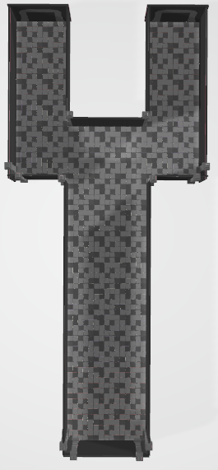
(x, z)
(2000, 1140~800)
(x, z)
(2000, - 200~ -450)
2000, 1140~868
2000, ??
경로1(왼쪽시작)
1 (2000, 1000)
2 (700, 900)
3 (430, 430)
4 (-2400, 500)
경로2(오른쪽시작)
1 (2000, -300)
2 (700, -350)
3 (430, 110)
4 (-2400, 100)
880, 730
880, -130
경로3(왼쪽시작)
1 (2000, 1100)
2 (700, 1000)
3 (430, 530)
4 (-2400, 600)
경로4(오른쪽시작)
1 (2000, -400)
2 (700, -450)
3 (430, 210)
4 (-2400, 200)
400, 1250
400, 730
400, -130
400, -670
-2418, -79
x
z
X : -2418 ~ 2000
Z : -670 ~ 1253

